Slide 1

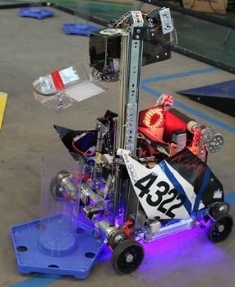

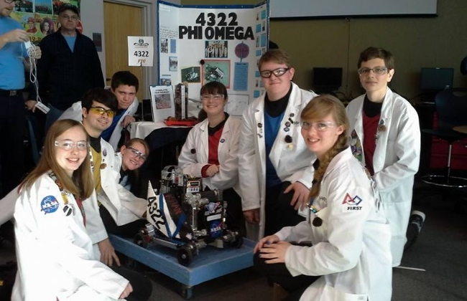
PHI Omega
4322
Khan
-Suspension
-Conveyer Belt
-Stick Shaping
Colossians 3:17
And whatever you do, whether in word or deed, do it all in the name of the Lord Jesus, giving thanks to God the Father through Him.

